Slide 1









WELCOME

Slide 2
WELCOME

Slide 3


AI vs. Human Mind: A Comparative Analysis
Exploring the strengths and limitations of artificial and human intelligence.
by Prodipto Mondal Sonnet

Slide 4
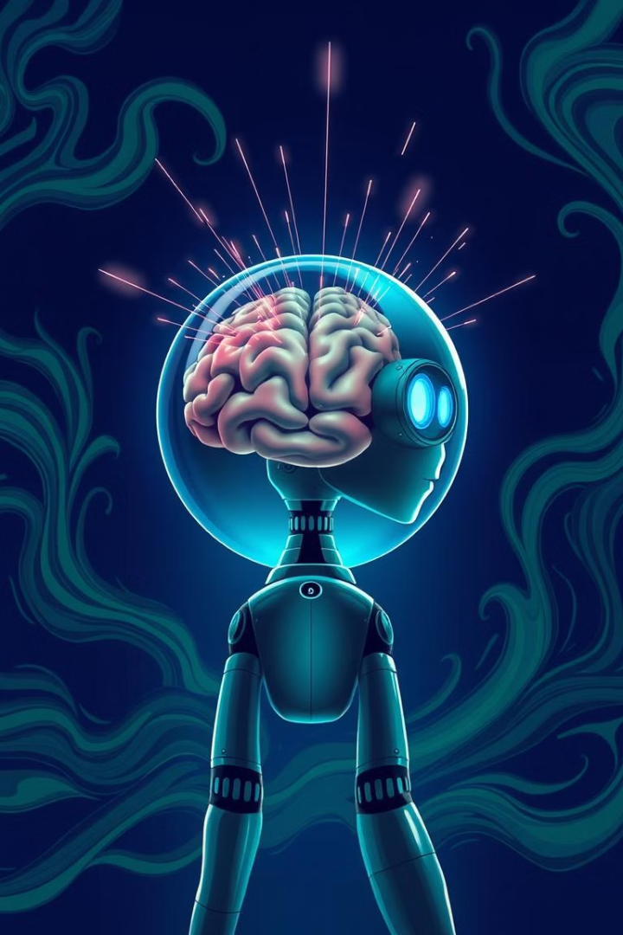
Artificial Intelligence
Human Intelligence
Definition and brief overview of AI.
The essence of human cognitive capabilities.
Purpose: A structured comparative analysis of AI vs. human intelligence.

Slide 5
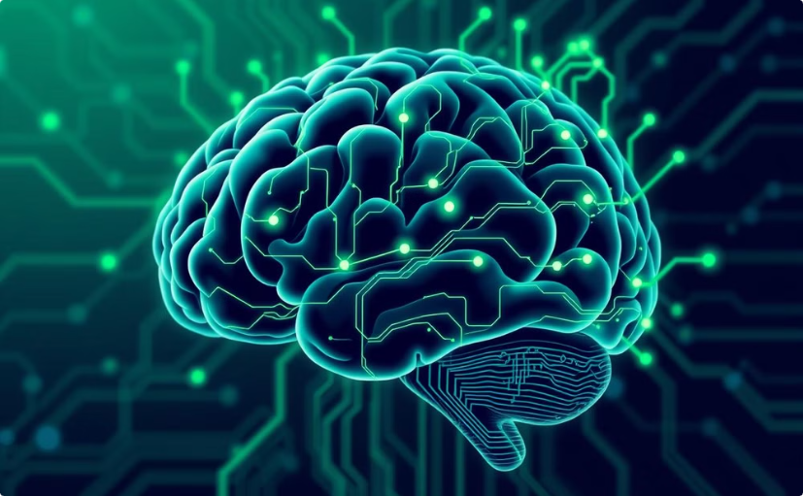
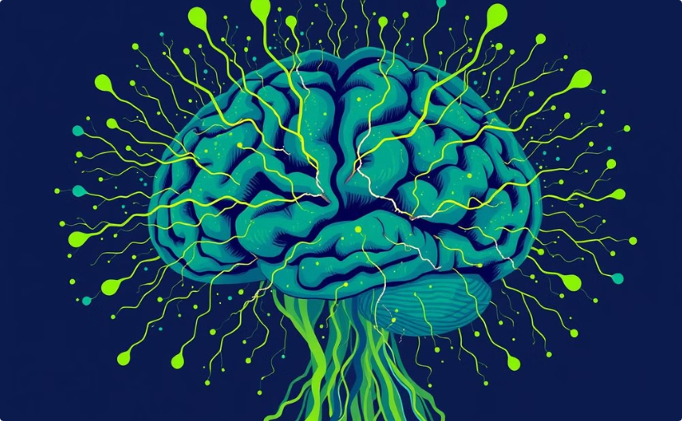
Learning & Adaptability
AI: Structured Data
Human Mind: Experience
Pattern-based learning from data.
Dynamic, creative adaptation through experience.

Slide 6
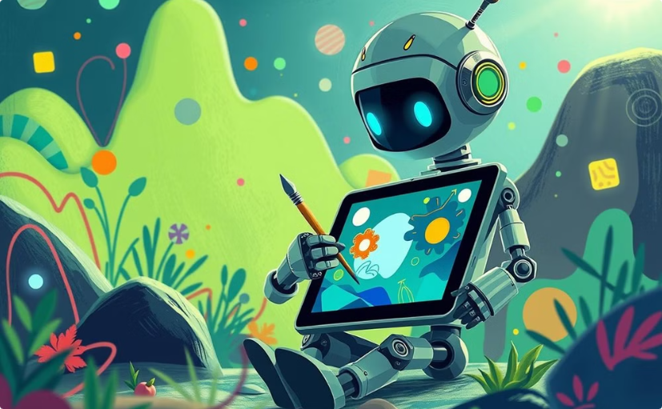

Creativity & Innovation
AI: Data-Driven Creation
Human Mind: Original Ideas
Generates content based on existing data and patterns.
Creates original ideas and imagines new possibilities.

Slide 7
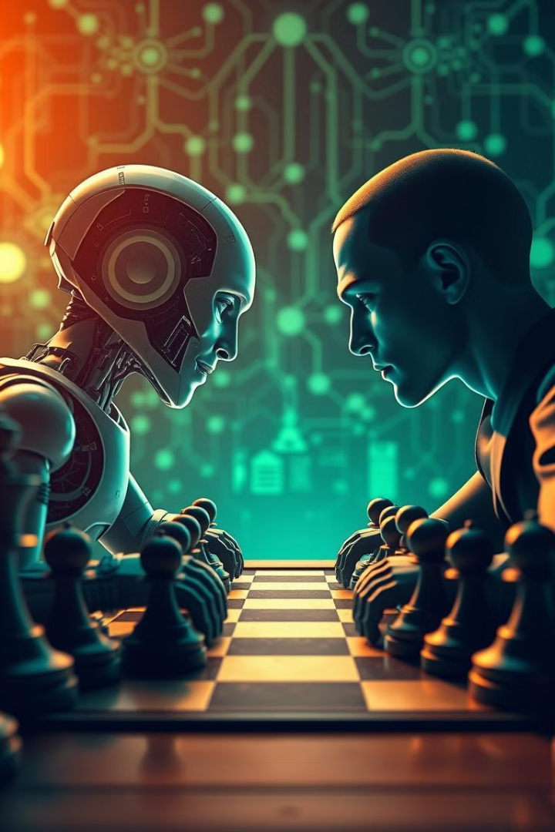
Problem-Solving
1
AI
Algorithms analyze data.
Fast with structured problems.
2
Human Mind
Logic, intuition, emotions.
Handles complex, ambiguous problems.

Slide 8
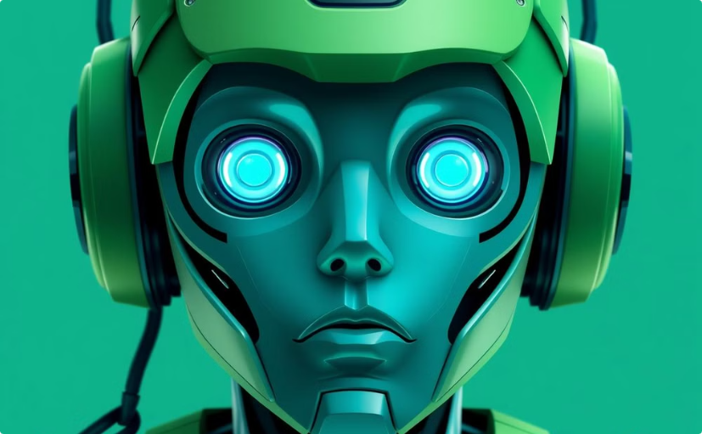

Emotions & Empathy
AI
Human Mind
Simulates responses.
Experiences real emotions.
Recognizes emotions.
Forms deep emotional bonds.

Slide 9
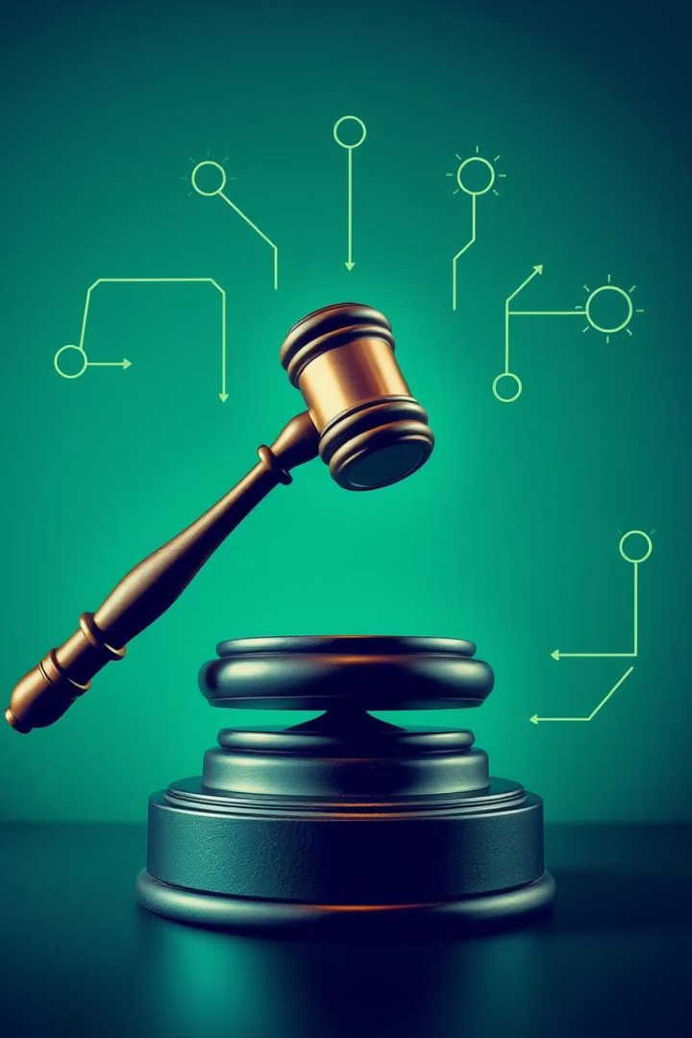


Ethics & Moral Judgment
AI
Follows rules and data.
Can inherit bias.
Human Mind
Moral reasoning, ethics, conscience.
Considers perspectives.

Slide 10

Future Possibilities
1
AI
Automation advancements.
Improved decision-making.
2
Human Mind
Continuous evolution.
Ethical AI development.

Slide 11
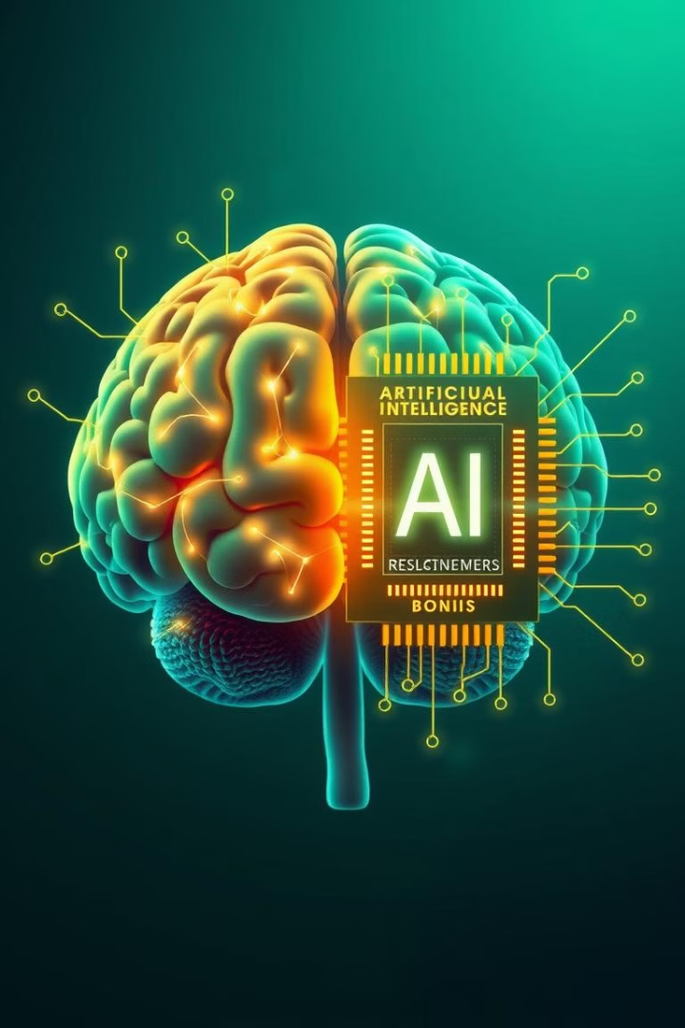
Key Strengths
AI
Data processing
Automation
Repetitive tasks
Human Mind
Creativity
Emotional intelligence
Ethical decisions

Slide 12

Conclusion
Future: AI assists, not replaces, humans.
AI excels at repetitive work.
Humans bring creativity and judgment.

Slide 13


